Slide 1
Insights to the Marketing Team in Food & Beverage Industry
By Archana

Slide 2
Introduction
CodeX is a German beverage company that is aiming to make its mark in the Indian market. A few months ago, they launched their energy drink in 10 cities in India.
Their Marketing team is responsible for increasing brand awareness, market share, and product development. They conducted a survey in those 10 cities and received results from 10k respondents

Slide 3
Problem Statement
To convert the survey results to meaningful insights which the team can use to gain a significant market share.

Slide 4
Resources Provided
Dataset required to generate Insights
Metadata
Survey questions

Slide 5
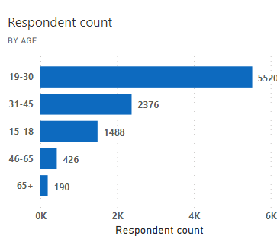
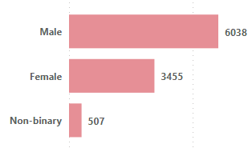
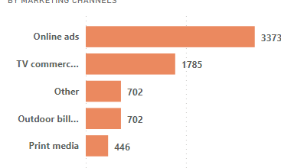
Primary Insights
1.Demographic Insights
a. Who prefers energy drink more?
Clearly "Male" Respondents prefers more energy drink
b. Which age group prefers energy drinks more?
It is evident that "Age Group – 19-30" prefers energy drinks more compared to other age groups.
c. Which type of marketing reaches the most Youth (15-30)?
As seen from the visual," Online ads" reaches the most Youth.

Slide 6
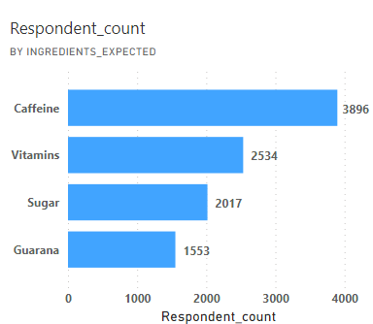
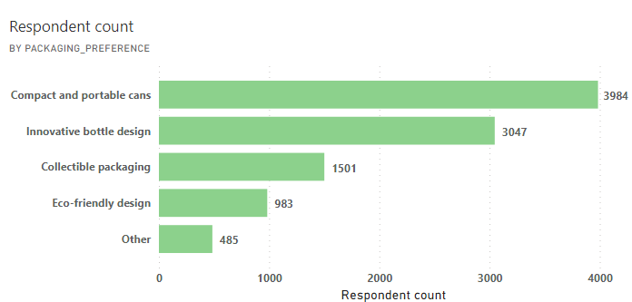
Primary Insights
2.Consumer Preferences:
a. What are the preferred ingredients of energy drinks among respondents?
Caffeine and Vitamins are the Top 2 preferred ingredients among respondents
b. What packaging preferences do respondents have for energy drinks?
It is evident that "Compact and Portable cans", "Innovative bottle design", "Collectible Packaging" are the Top 3 Packaging preferences among respondents.

Slide 7
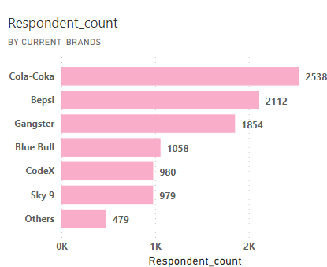
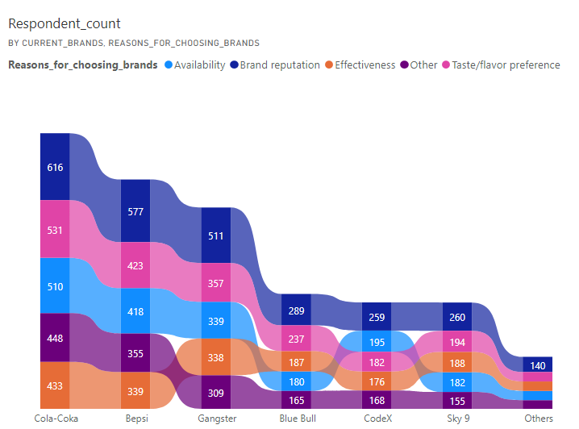
Primary Insights
3.Competition Analysis:
a. Who are the current market leaders?
Cola-Coka, Bepsi, Gangster, Blue Bull are the Top 3 Current Market leaders
b. What are the primary reasons consumers prefer those brands over ours?
It is evident from the ribbon chart that the primary reasons consumers preferring other brands are "Brand Reputation", "Availability", "Taste/flavor preference.

Slide 8
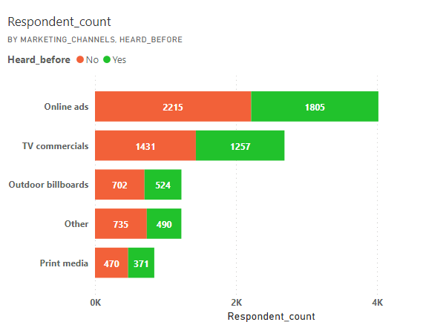
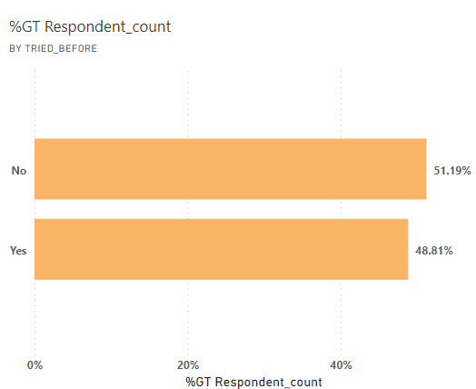
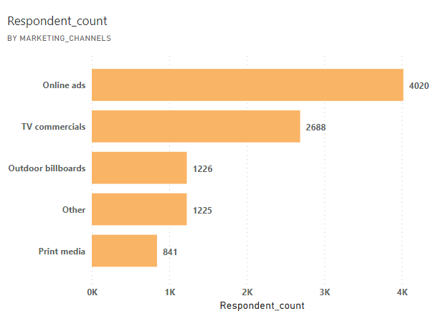
Primary Insights
4.Marketing Channels and Brand Awareness:
a. Which marketing channel can be used to reach more customers?
Online ads and TV commercials can be leveraged to reach more customers.
b. How effective are different marketing strategies and channels in reaching our customers?
It is evident from the bar chart that the marketing channels reached 44.5% of respondents.
This indicates the need to increase Online ads and TV commercials

Slide 9
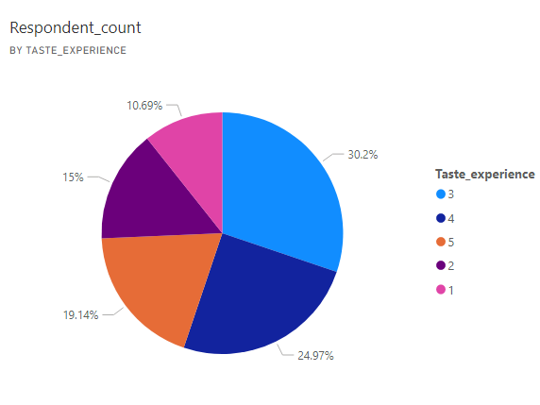
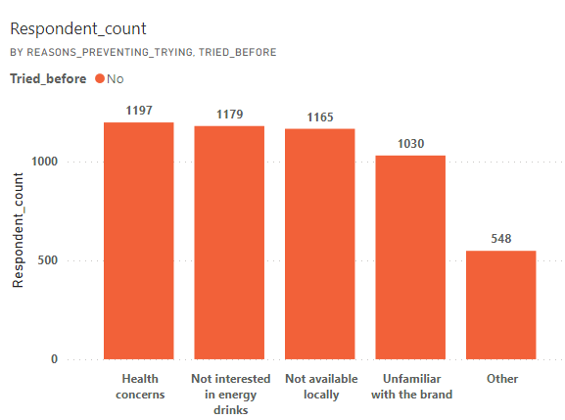
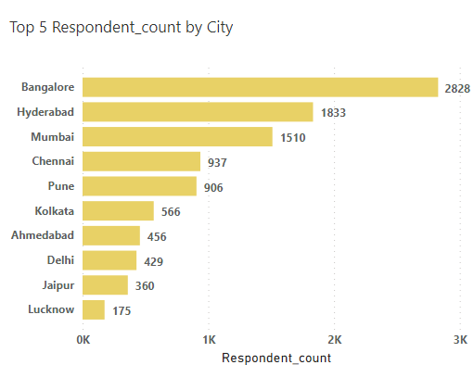
Primary Insights
5.Brand Penetration:
a. Which cities do we need to focus more on?
Overall respondents who have tried our brand has given a rating of 3 out of 5 for taste experience.
b. Which cities do we need to focus more on?
We need to focus more on Tier 1 cities to increase the market share. Also, the main reason preventing respondents for trying our brand in Tier 2 cities are:
-Not available locally
-Unfamiliar with the brand

Slide 10
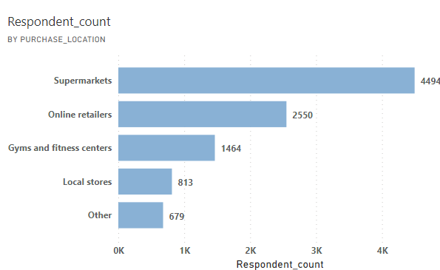
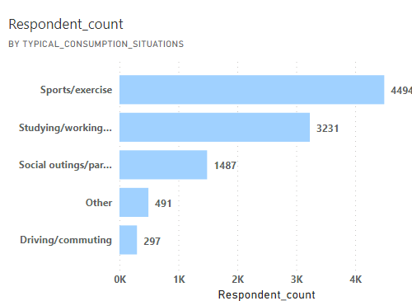
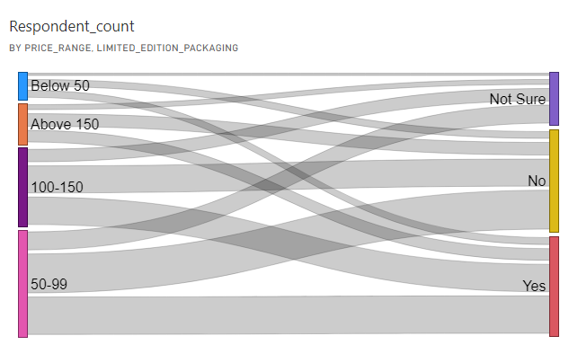
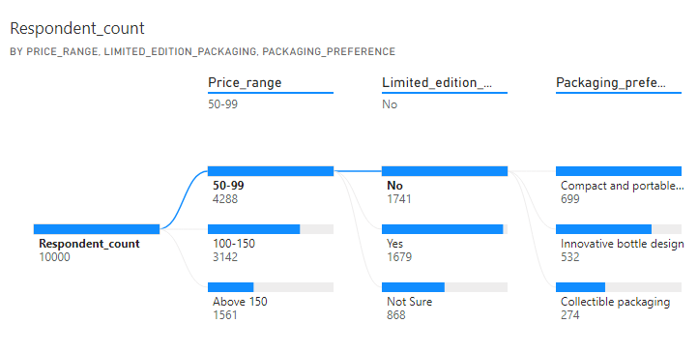
Primary Insights
6.Purchase Behavior:
Where do respondents prefer to purchase energy drinks?
Respondents prefer supermarkets, Online retailers, Gyms and fitness centers as Top 3 locations.
b. What are the typical consumption situations for energy drinks among respondents?
Typical consumption situations for energy drinks among respondents are
Sports/exercise, studying/working, Social outings/parties.
c. What factors influence respondents' purchase decisions, such as price range and limited-edition packaging?
From the visuals, it is evident that price range, limited edition packaging , package preferences play a key role in respondents purchase decisions.

Slide 11
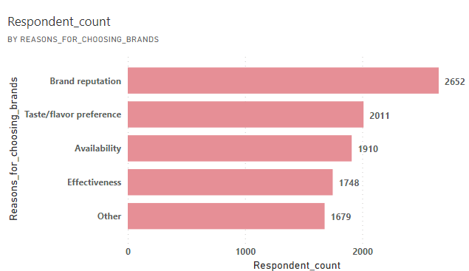
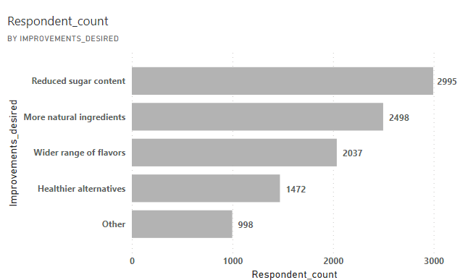
Primary Insights
7.Product Development:
Which area of business should we focus more on our product development?
We should focus more on branding the product which can be achieved through various online ads, promotional ads, TV commercials.
The other important area is Taste/flavor Preference as most of the respondents who have tried our brand gave average rating.
Making the product locally available increases the chance of holding the position and expanding the business.

Slide 12
Secondary Insights
Recommendations for codex
Pricing the product low and promising quality to gain a significant market share: It is evident in the visuals that price range and respondent's considerations of improvements desired in the product play a key role in achieving this.
Product's Availability and Promotions: We have seen that the primary reason of preventing consumers our product is its unavailability in local stores in each city and health concerns and unfamiliarity with the brand.
Taking steps to stock the product in the local stores/convenience spots
further the sales of the product. Collaborate with grocery stores,
convenience stores, gyms, and cafes to secure prominent shelf space.
3. Product's Differentiation: Respondents who have tasted our product,
given a rating of 3 out of 5. Differentiating the product by highlighting
Respondents preferred ingredients, innovative flavors, preferred packaging will set the product apart and attract the customers.
4. Marketing channels and partnerships: Increasing online ads,
commercials TV channels attracts the target age group. Sponsoring
local sports teams, fitness events to establish a connection with customers and generate positive brand reputation.

Slide 13
Thank you

